Slide 1

Systems Development Life Cycle
OLSAT Monitoring System for Xavier School TRC

Slide 2

Rapid Application Development
Chosen SLDC for the Project

Slide 3
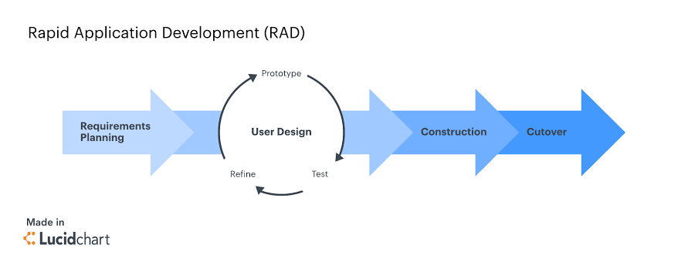
RAD in a nutshell

Slide 4

First off, what is RAD?
Rapid Application Development, or RAD is:
A method of software development which heavily emphasizes rapid prototyping and iterative delivery.
Focuses largely on planning and sequential design practices.
One of the popular and powerful development methods up to date.
Parent category of AGILE development technique.
A sharp alternative to the typical Waterfall model.

Slide 5
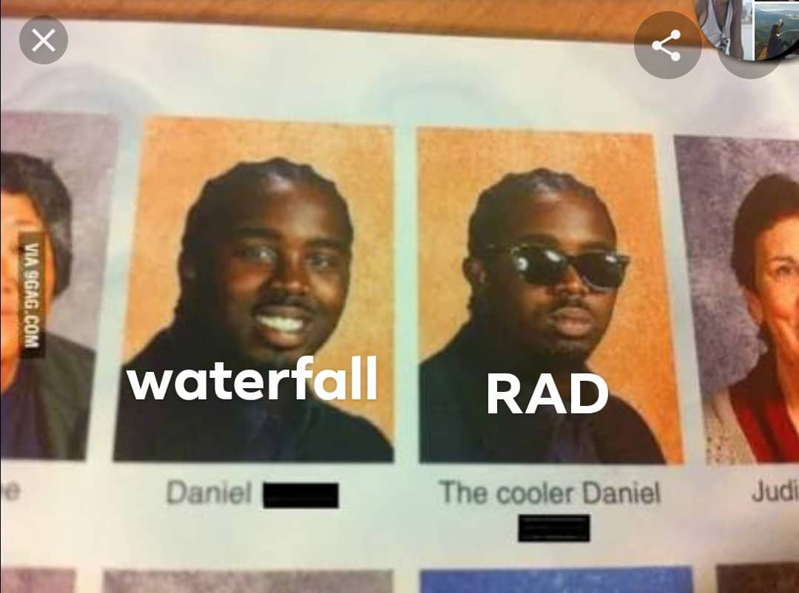

Slide 6

Yeah okay, then why RAD?
We picked RAD because:
RAD makes use of the aggressive knowledge utilization and discoveries by the developers of the project.
Makes the project more malleable, thanks to constant client contact.
Adaptive and flexible nature.

Slide 7

Let’s take a few RADical steps (get it?)
Planning
Application Design
Iterative Construction
Cutover
Overall project planning
Client specification requirements
Setting Standards
Role briefing
User feedback
Wireframing, Prototyping
Coding, Testing, all that good stuff
Improvements
Client feedback
Live Production
TRC Office Software Training

Slide 8

Tell me more about it.
Pros of Rapid Application Development
Measurable Progress
Quickly Generate Productive Code
Rapid, Constant User Feedback
Early Systems Integration
8

Slide 9

Sounds good.. Or does it?
Cons of Rapid Application Development
Requires Modular Systems
Difficulty Within Large-Scale Projects
Demands Frequent User Interfacing
Team Compatibility
9

Slide 10
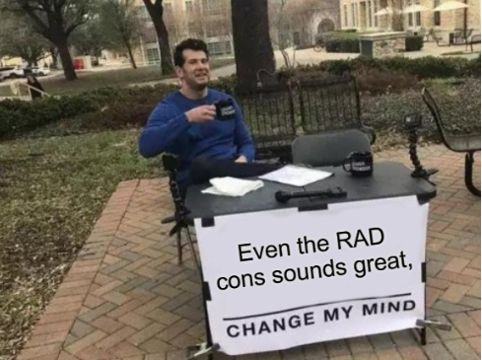

Slide 11

THANK YOU

